Slide 1
Newton-Raphson Method
For any function f (x), the tangent is a close approximation of the function for some small distance from the tangent point.
We call the equation of the tangent the linearization of the function.

Slide 2
Start with the point/slope equation:
linearization of f at a
is the standard linear approximation of f at a.
The linearization is the equation of the tangent line, and you can use the old formulas if you like.

Slide 3
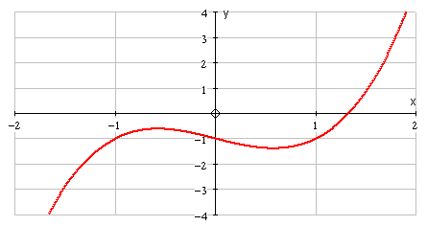
Suppose we want to find an approximate solution to the equation
To see how the method works, we’ll sketch
using .
The root lies between 1 and 2.
We’ll zoom in near

Slide 4
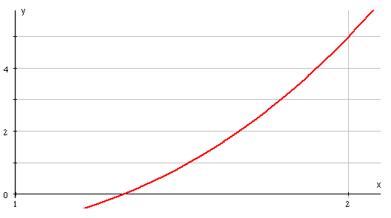
Suppose our first estimate is given by
We draw the tangent to the curve at
The point where the tangent meets the x-axis we call
we repeat that to find …… until we find the root

Slide 5
To carry out the iteration we need to find the points where the tangents meet the x-axis.
x
The grad. of the tangent

Slide 6
We have and we need to find .
Rearranging:

Slide 7
So,
We just need to alter the subscripts to find :
Generalising gives
We don’t need a diagram to use this formula but we must know how to differentiate .
Convergence is often very fast.

Slide 8
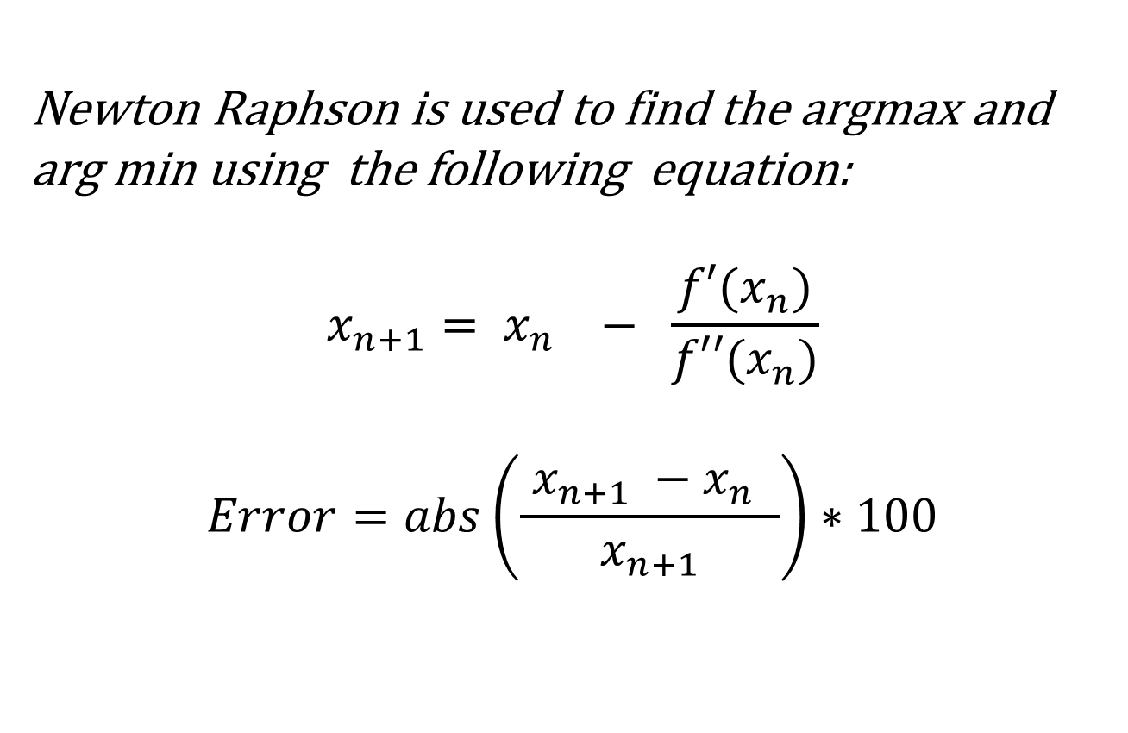
Newton Raphson is used to find the argmax and arg min using the following equation:
$$x_{n+1}= x_{n} − \frac{f′(x_{n})}{f′′(x_{n})}$$
$$Error=abs\left(\frac{ x_{n+1} −x_{n }}{x_{n+1}}\right)∗100$$

Slide 9
(a)
Solution: Let

Slide 10
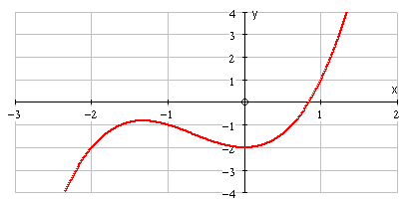
(b) What happens if you use ?
The iteration fails immediately.
At x = 0, there is a stationary point.
(c)
At a stationary point
so in the formula we are dividing by 0.
We also notice that the tangent never meets the x-axis.

Slide 11
2. Use the Newton-Raphson method to estimate one root of
to 4 d.p. using
Solution:
Let
Radians!

Slide 12
i.e. at a stationary point
The Newton-Raphson method will fail if
It will also sometimes fail to give the expected root if the initial value is close to a stationary point. Can you draw a graph to show what could happen in this case?
This is one example.

Slide 13
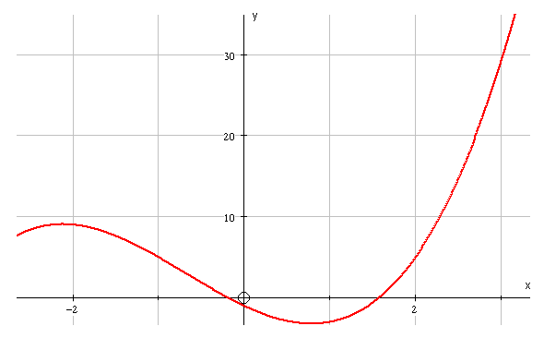
With the iteration gives the root
instead of the closer root .

